Slide 1


Keyboard Snooping from Mobile Phone Arrays
UbiComp 2019
Darwin Deason Institute for Cybersecurity
Southern Methodist University

Slide 2
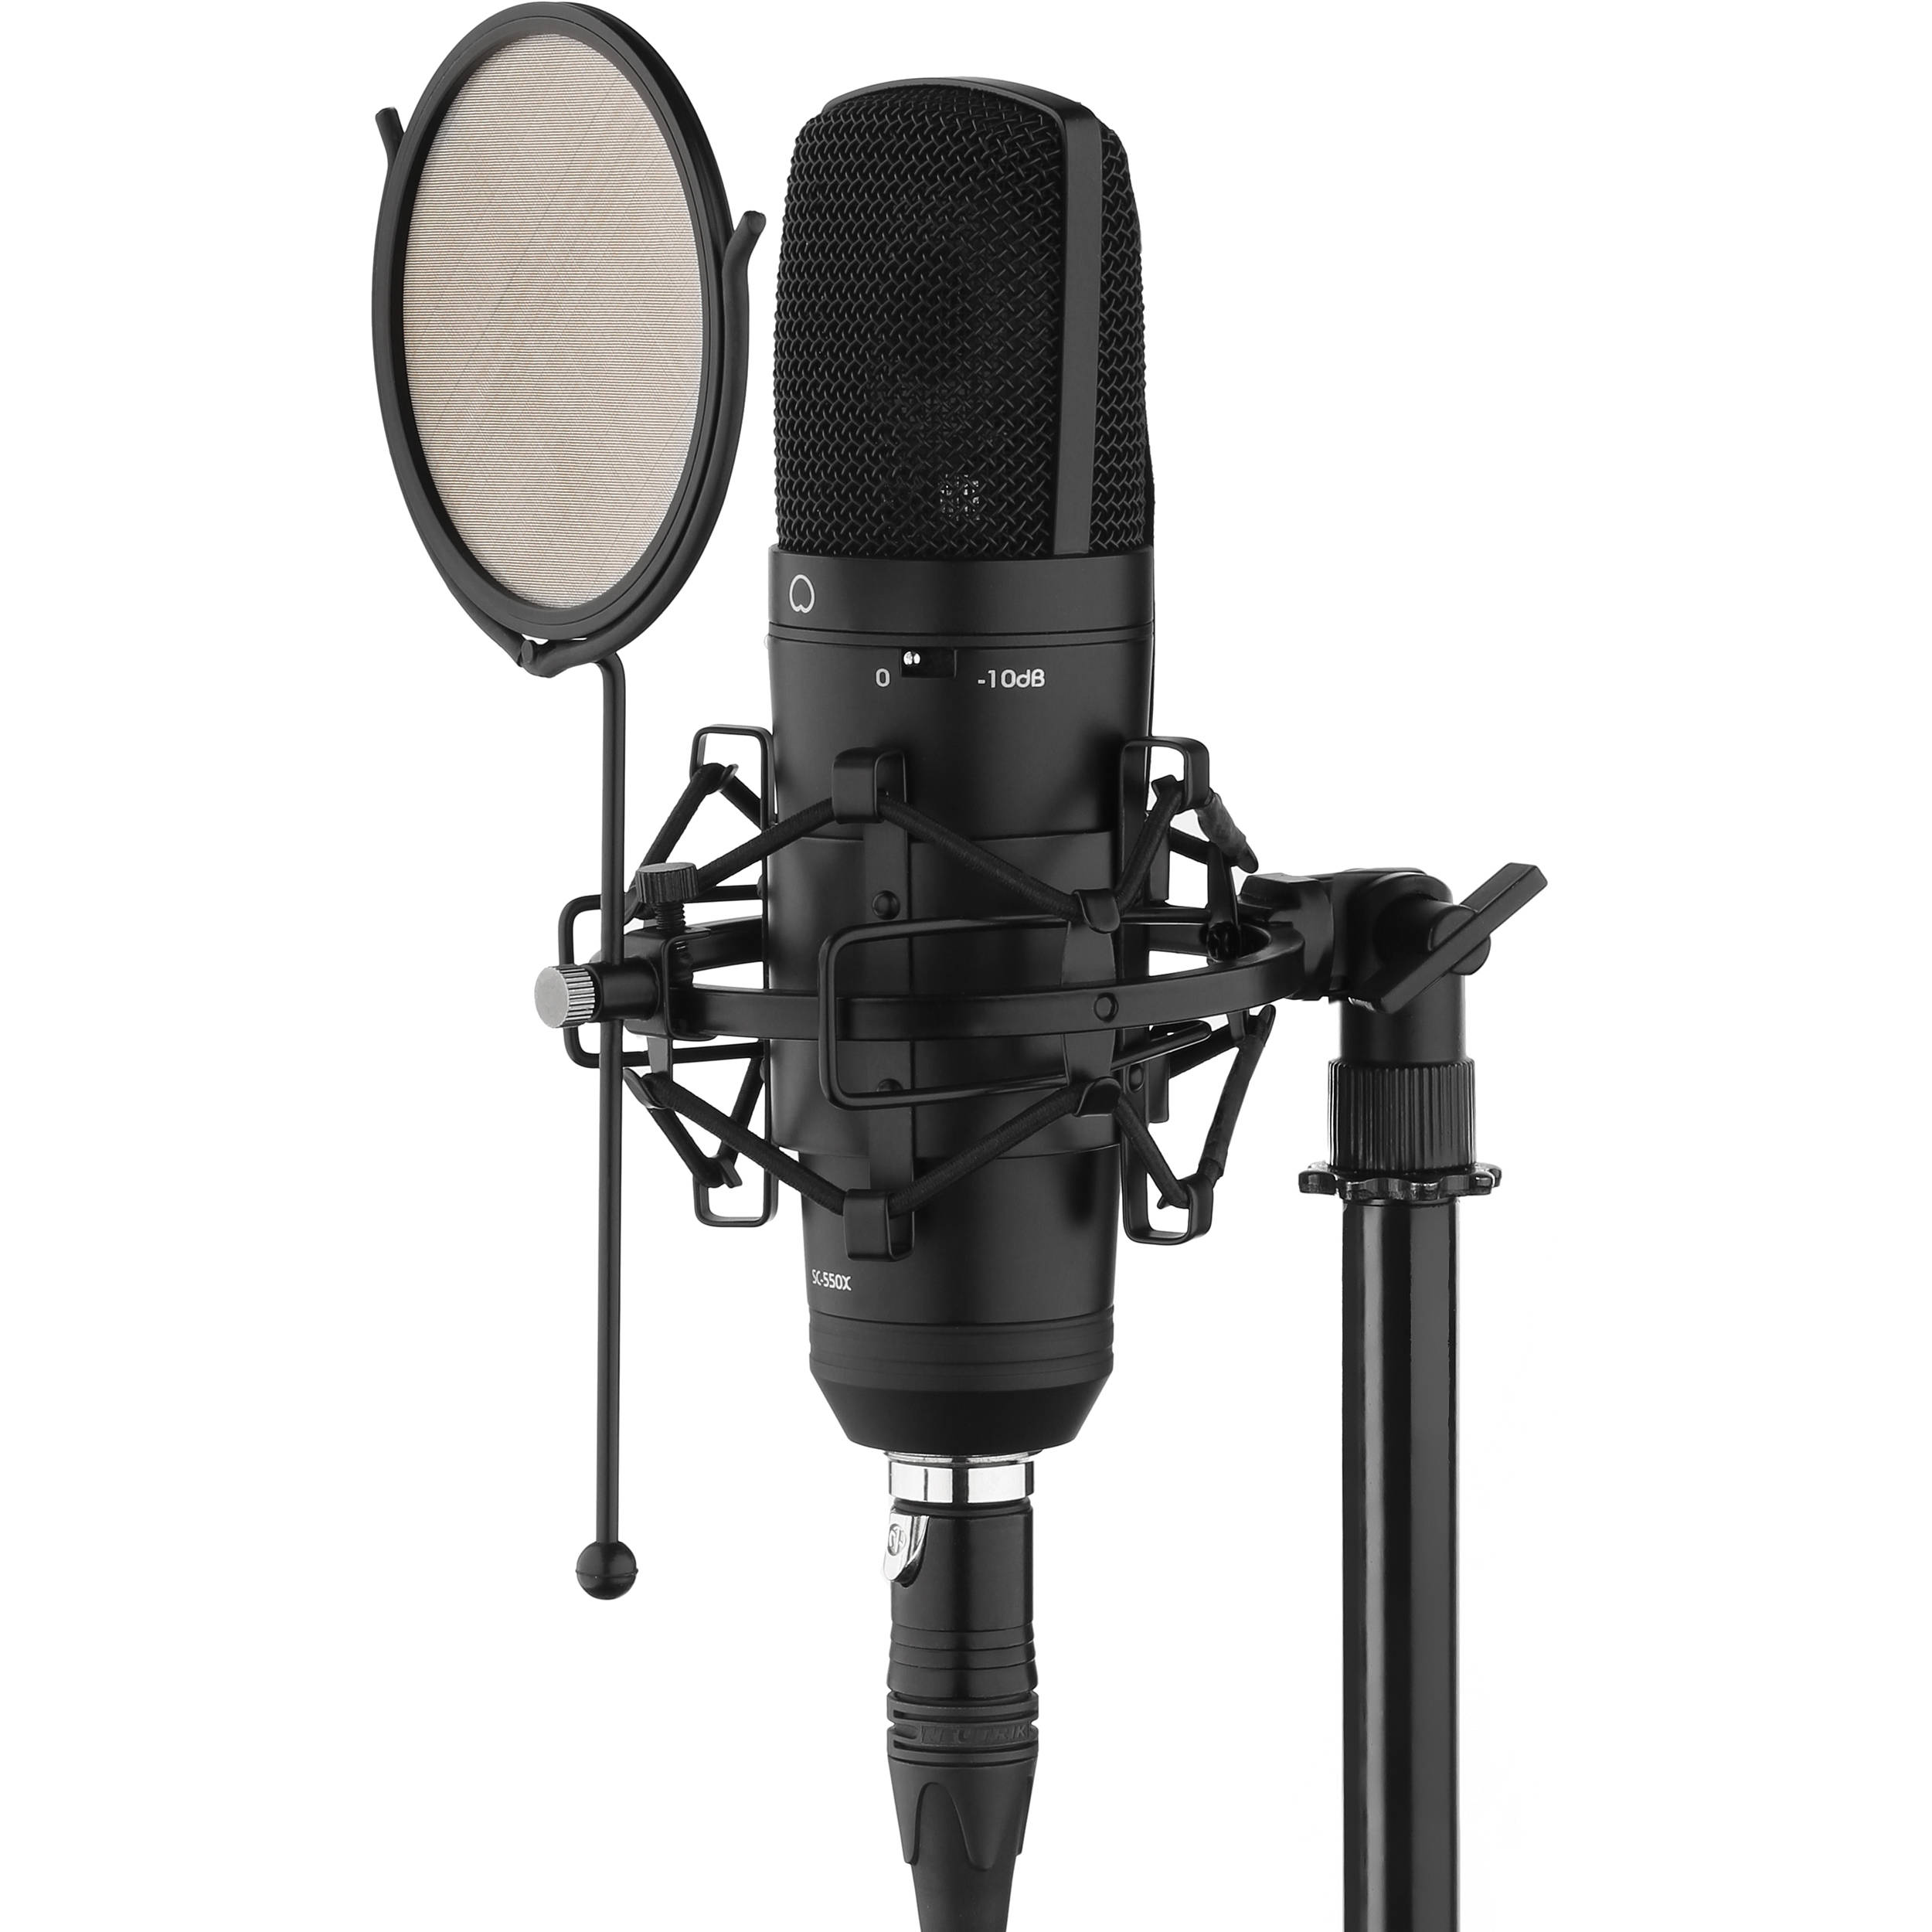
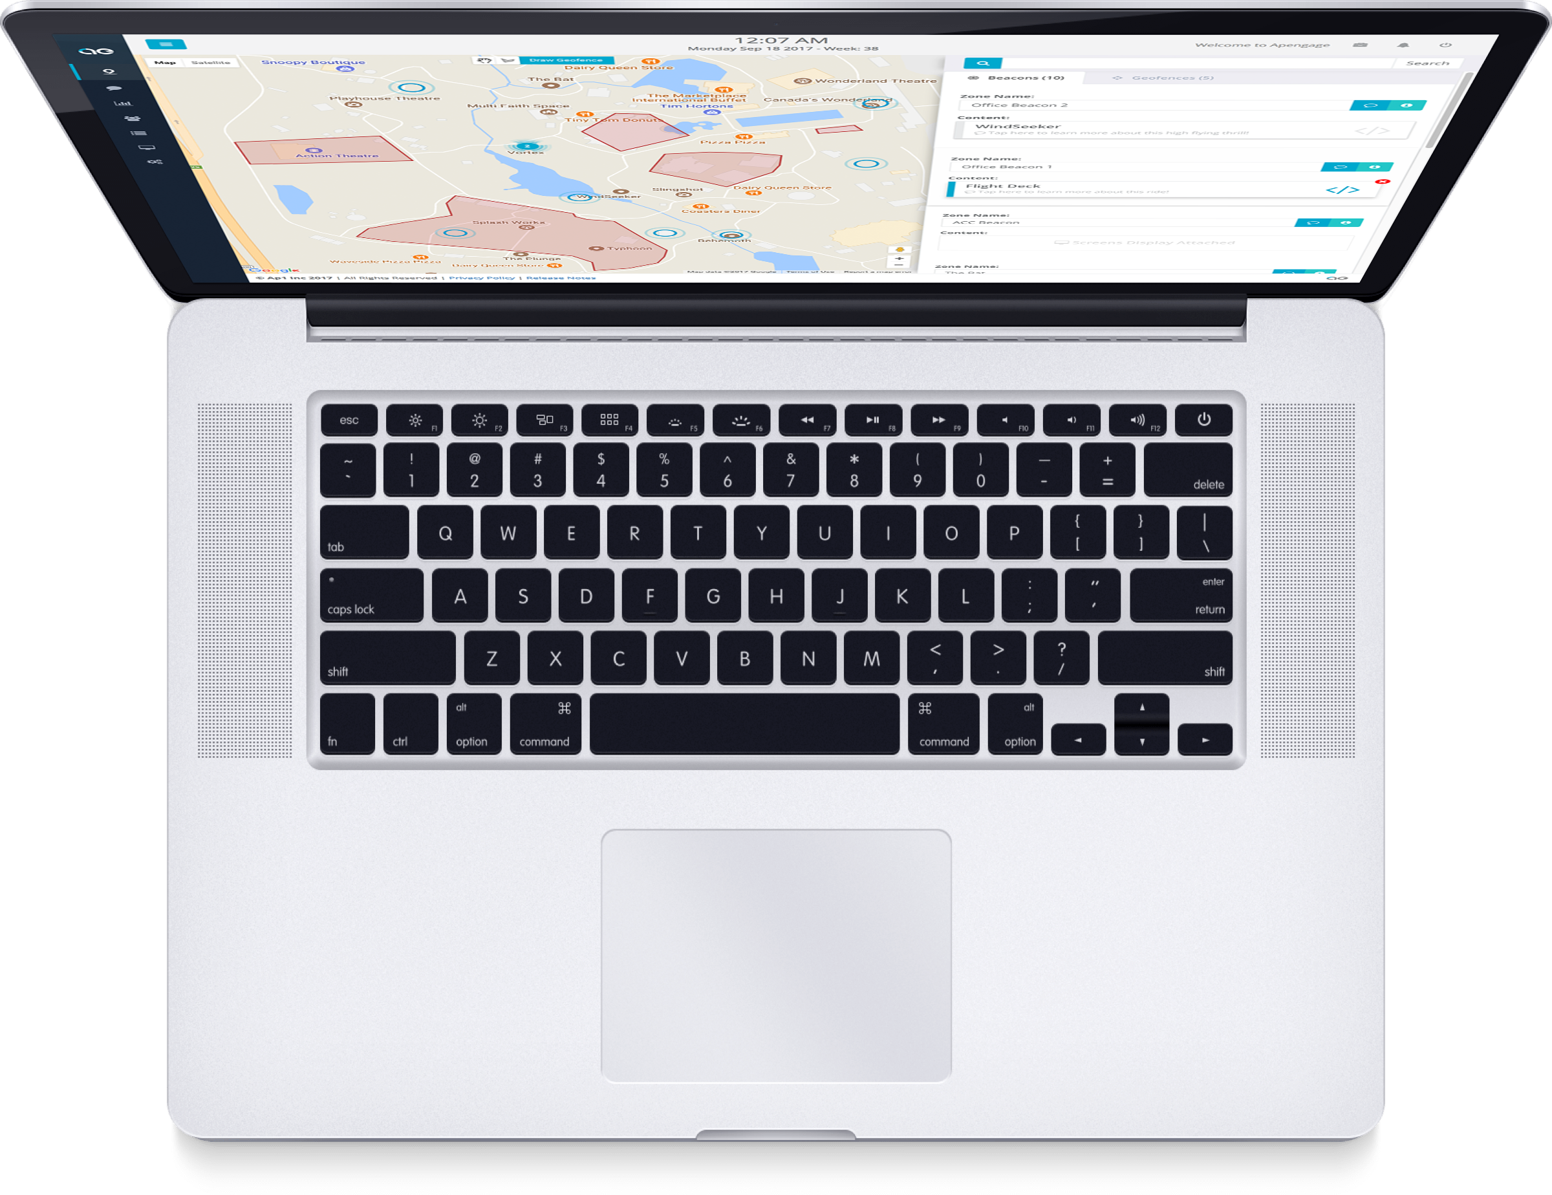
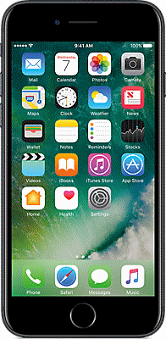

Keyboards are Vulnerable to Side Channel Attacks
Audio
Kelly et al. 2010, Zhuang 2009
Slow typing, one user
Studio microphone
Motion
Marquardt et al. 2011
Slow key presses
Limited Vocabulary
Areas for Improved Investigation
Natural typing speed
Background noise
Exclusively smartphone sensors
Unrestricted vocabulary

Slide 3
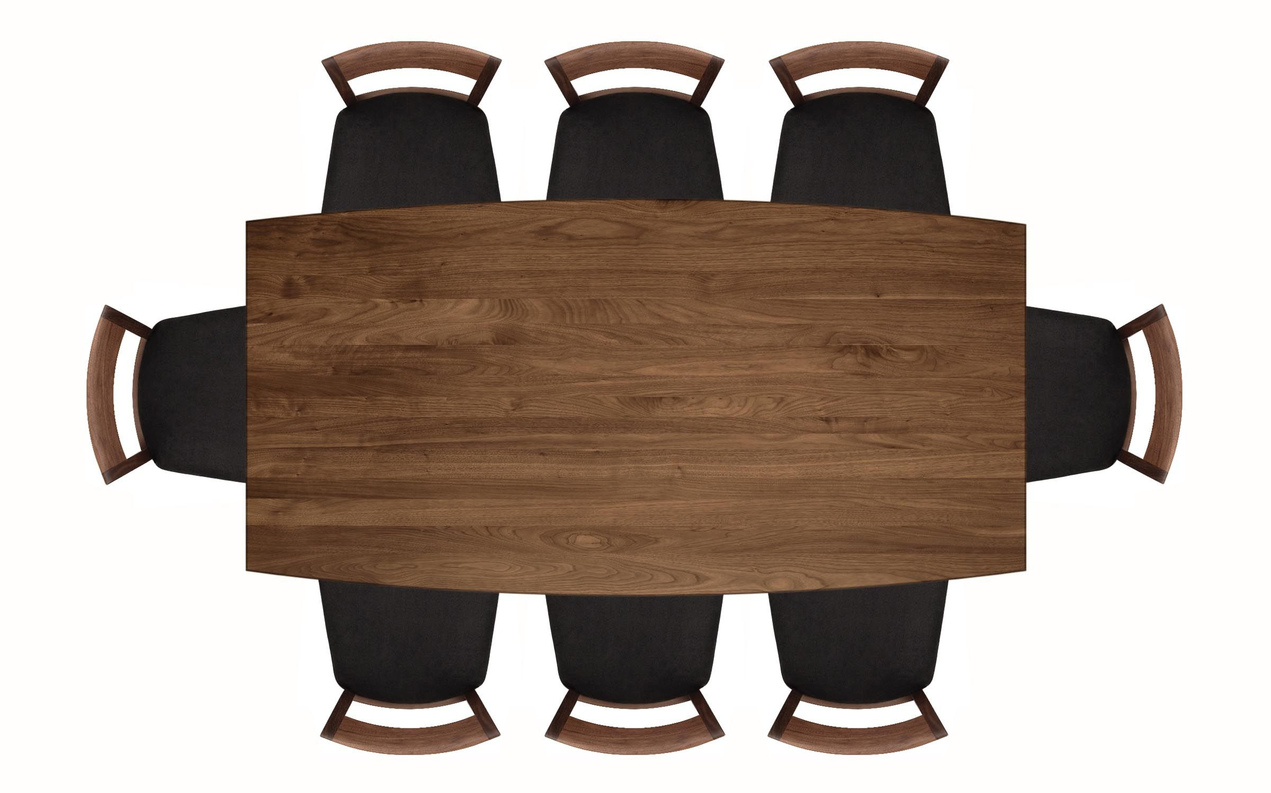
Attack Scenario

Slide 4
Keystroke Sensor Response
Frequency (Hz)
Initial Keystrike
Table response
Source-Filter Model
Source: Keystrokes (hand position, pressure, speed)
Filter: Table, Room, and Keyboard
Second Keystrike
Audio FFT Magnitude
X and Z Motion Data
Releasing first key
Time
Time

Slide 5
Modeling Overview
Each Phone Sensor Data
Detect Keystrokes (Convolutional)
Combine Phone Data
Classify Keystrokes (Convolutional)
Language Model
Preprocessing
Classify Keystrokes (Recurrent)
Extract Features

Slide 6
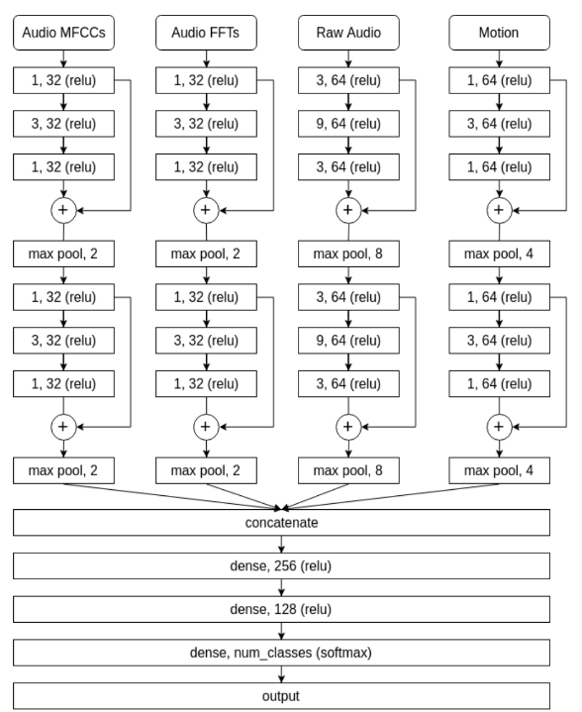
Convolutional Architecture
Multi-Modal Architecture:
Combines audio and motion
1D convolutions
Residual connections
Multi-Task Architecture:
Keystroke detection network
Keystroke classification network
Shared convolutional and dense layers
See section XX for more information

Slide 7
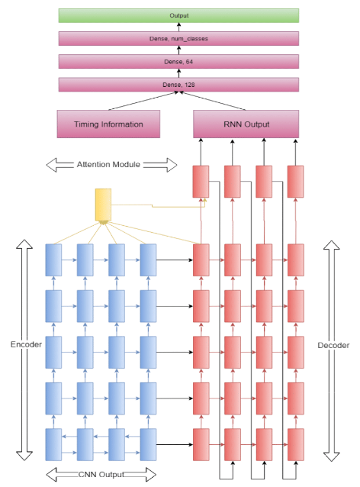
Recurrent Architecture
Encoder-Decoder Architecture:
Attention module for looking at multiple keystrokes
Bidirectional encoder allows sequence look ahead
Timings between keystrokes as an additional feature
See section XX for more information

Slide 8
Language Model
Correct for backspace, left/right arrows
Segment words based on fixed window/whitespace
Match with Viterbi decoding to English-language words

Slide 9
Data Collection
20 participants at natural typing speed
4 iPhones (5s, 6s, 7+)
3 styles of keyboard
~162,000 keystrokes
41% of keystrokes collected while talking present
Subject-level Cross Validation

Slide 10
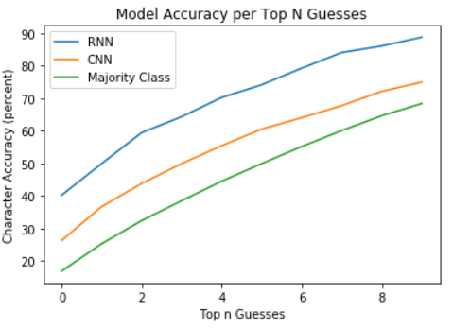
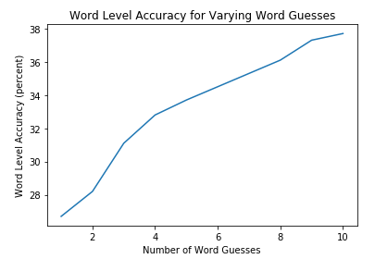
Results
Character Level
Word Level
~89%
Accuracy (%)
~42%
Actual typed word in the top ten guesses ~38%
Top N

Slide 11
Real Time System

Slide 12
Risk Assessment
Train/Test on Different Tables
Chance Prediction
Train/Test on Different Keyboards
5-6% drop in word level accuracy
Same Table, Different Room
2-4% drop in word level accuracy
Altered Phone Positions
4-8% drop in word level accuracy

Slide 13
Conclusions
Current Threat: Medium risk – attacker needs reasonable prior information (type of table, type of keyboard) and ML knowledge
Future Work: Can the attack generalize to new tables if the attacker compensates for table transfer function and source excitation?

Slide 14



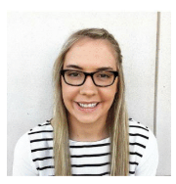



Thank You!
Corresponding Author:
Tyler Giallanza
Undergraduate Senior
tylergiallanza@gmail.com
Student Author:
Travis Siems
Student Author:
Erik Gabrielsen
Student Author:
Elena Sharp
Student Author:
Ian Johnson
Faculty Author:
Eric Larson
Faculty Author:
Mitchell Thornton

